Slide 1
Partner Agency Meeting
June 28, 2023

Slide 2
Mute phone
Unmute when ready to speak and identify your name and CU so we know who is speaking

Slide 3
Agency Relations Team
Kim Bartenstein, director of mission and quality assurance
Naomi Save, agency partner network manager
Jared Kawatani, community program manager
Jennifer Schantz, kapuna programs manager
Stephanie Rivera, program support assistant
Sonomi Espinosa, program support assistant

Slide 4
Hawaii Foodbank’s Mission
The people of Hawaii are one ʻohana. Hawaii Foodbank provides food so that no one in our family goes hungry. We work to gather food and support from our communities. We then distribute food through charitable agencies to those in need.

Slide 5
Feeding America (FA) Network
Feeding America is a United States-based nonprofit organization. They are the nation’s largest domestic hunger-relief organization. Their nationwide network of more than 200 food banks feed more than 46 million people through food pantries, soup kitchens, shelters, and other community-based agencies.

Slide 6
What does FA offer?
Provides us access to:
National Donors
Food Sources
Grant Funding
Purchasing at Lower Costs
Other Resources

Slide 7
Agency Application

Slide 8
Agency Application
Agency Membership Application
Partner Agency Agreement
501(c)(3) Tax Determination Letter
Current Food Safety Certification

Slide 9
Food Safety
Designate a coordinator and provide us with their contact information
Changes or updates must be submitted to HFB within 10 days
Food safety certification
At least one person per agency (who will need to be on property at the time of distribution)
Food safety concerns
Take photos & contact the agency relations department
Food recalls
Periodic mock recalls
Agencies are required to respond to this email within 24 hours

Slide 10
Monitoring
At least annual monitoring
Site visit or mystery shopper
CSFP – quarterly monitoring
Funder audits

Slide 11
Hawaii Foodbank Programs

Slide 12
Agency Type
Pantry
Outreach
Snacks
Shelter
Soup Kitchen
Ohana Produce Plus

Slide 13
Hawaii Foodbank Programs
Ohana Produce Plus Program
Food 4 Keiki Program
Feeding Our Future / Summer Food Service Program (SFSP)
School & Keiki Pantries
Government Programs

Slide 14
Ohana Produce Plus Program
Partner agencies distribute 10 -20 pallets of fresh produce, assorted dry goods, and nonperishable items to underserved communities
~ 35 Ohana Agencies
~9-17 distributions per week
~ 51 distributions per month

Slide 15
Food 4 Keiki: Feeding Our Future Program Summer Food Service Program
Sodexo Foundation purchases approximately $25,000 of food
Food is stored at the Sodexo facility at the University of Hawaii at Manoa, where the staff cook hot meals for participating Foodbank agencies to pick up and distribute
5 partnering agencies

Slide 16
Food 4 Keiki: School & Keiki Pantry Program
18 schools on Oahu
Parnter with existing school partners when possible
~5 lb bag of food and snacks
Once a week or twice a month

Slide 17
Contracted Programs

Slide 18
Contracted Programs
Temporary Assistance for Needy Families (TANF)
The Emergency Food Assistance Program (TEFAP)
State Emergency Food Assistance Program (SEFAP)
Senior Farmers’ Market Nutrition Program (SFMNP)
Commodity Supplemental Food Program (CSFP)

Slide 19
Temporary Assistance for Needy Families (TANF)
Partnership with Department of Human Services
Provide TANF products for household consumption only to low-income families, with children under the age of 18, residing in the County of Honolulu or the County of Kauai, whose total gross income is no greater than 300% of the amount specified in the 2022 Federal Poverty Guidelines
Separate reporting

Slide 20
TANF Qualifications
Household income cannot exceed 300% of the 2022 Federal Poverty Level.
Two person household – no more than $5,265 monthly – no more than $63,180.00 annually
A family has at least 1 child under the age of 18 years old living in the household.
One adult in the household must be a parent or relative of the child through blood or marriage.
ALL members of the household must be a U.S. citizen.

Slide 21
TANF Distribution Log

Slide 22
The Emergency Food Assistance Program (TEFAP)
Partnership with Office of Community Services
Helps to supplement the diets of low-income individuals or households, including elderly people, by providing them with emergency food and nutrition assistance at no cost
~110 participating agencies

Slide 23
TEFAP Qualifications
Are residents of the City and County of Honolulu;
Are lawfully present in the United States, but need not be citizens of the United States; and
Must not exceed 185% of the Poverty Level
One person household – no more than $28,915.50
Two person household – no more than $38,961.00 annually

Slide 24
State Emergency Food Assistance Program (SEFAP)
Partnership with Office of Community Services
Helps to supplement the diets of low-income individuals or households, including elderly people, by providing them with emergency food and nutrition assistance at no cost

Slide 25
SEFAP Qualifications
Are residents of the City and County of Honolulu;
Were adversely affected by the COVID-19 pandemic;
Are lawfully present in the United States, but need not be citizens of the United States; and
Must not exceed 185% of the Poverty Level
One person household – no more than $28,915.50
Two person household – no more than $38,961.00 annually

Slide 26
Commodity Distribution Log

Slide 27
Senior Farmers’ Market Nutrition Program (SFMNP)
Provides seniors that have low incomes with eligible produce
Receive $5.00 voucher booklets, valued at a total of $50.00 USD
Vouchers can be redeemed at participating Farmers' Market vendors, in exchange for fresh fruits and vegetables

Slide 28
SFMNP Qualifications
At least 60 years or older
Resident of Hawaii
At or below 185% of the poverty guidelines
1 person - $28,915.50
2 person - $38,961.00

Slide 29
Commodity Supplemental Food Program (CSFP)
Known as the Senior Food Box Program, was first launched in April 2015.
Hawaii is one of the U.S. states that participates in CSFP to distribute food boxes to improve the health of seniors with low income.
Boxes contain supplemental foods such as nonfat dry milk and/or UHT milk, cheese, cereal, juice, peanut butter, rice, canned meat, fruits and vegetables.
~29 distribution partners

Slide 30
CSFP Qualifications
60 years or older
Residents of Oahu & Kauai – This program operates on two islands
Valid photo identification
At or below 130% of the poverty guidelines (see household table on application)
1 person - $1,817 monthly, $21,804 annually
2 person - $2,457 monthly, $29,484 annually

Slide 31
Civil Rights Training

Slide 32
Hawaii Foodbank Distribution Center

Slide 33
Partner Agency Expectations
All partners, regardless of shopping/distribution activity, must submit a Monthly Agency Activity Report by the 5th of the following month
Failure to submit complete report on time will result in your account being placed on hold. An account on hold will not be able to receive any product until the account has been brought current
All partners are required to follow all the rules set forth by HFB

Slide 34
Shopping Orientation
Scheduling appointments - must be done online
Appointments cannot be scheduled within 24 hours or more than one week in advance
Partner Agencies may only visit the distribution center once per day
Same day appointments are not allowed
Parking – agency parking stalls are marked (stalls 11 – 21), you are allowed to use two (2) stalls during your appointment time
ID Cards/Authorized Shoppers
An authorized shopper is someone your organization has appointed to sign the invoices
The authorized shopper will be issued a shopper ID card – see agency relations office
Helpers will need to be issued a paper badge – see agency partner services coordinator
Adding and removing authorized shoppers on the account needs to be done in writing (email is acceptable)
Shopping List – when you come in to pick up food the scalers will weigh you out and have you sign the shopping list (this is not your invoice. After you load your items in your vehicle, please return to the window to sign your invoice.
Invoices - every time you receive food from Hawaii Foodbank you should be signing an invoice and receiving a copy for your records
Statements – statements are mailed monthly to the billing address provided in writing
Payments – invoices/statements must be paid with an Agency check
HFB does not accept personal checks, credit card payments or cash

Slide 35
Distribution Center Rules
Follow all Distribution Floor/Shopping Rules posted
Maximum of three shoppers per agency - one (1) shopper needs to be an authorized shopper
Shoppers must wear closed-toe shoes (the top of the food and the heel should be covered)
Shoppers must be at least 16 years old
Women over six (6) months pregnant are not allowed to shop
Shoppers are allowed to use up to three (3) carts per agency
Do not open case lot items – if you are unsure, please ask warehouse staff for assistance
While in the chill area, all shoppers must wear gloves when touching exposed produce
When taking refrigerated and frozen product you must bring a cooler, thermal blanket or refrigerated vehicle to ensure safe transport
This is a working warehouse, please be aware of your surroundings at all times
All product originating from HFB is to be used exclusively for the agency you represent and is not for sale or personal use

Slide 36
Keeping Records
All files must be kept for 3 years – Notice will be sent out when files can be destroyed. Scanned copies of these items are allowed.

Slide 37
Monthly Reporting

Slide 38
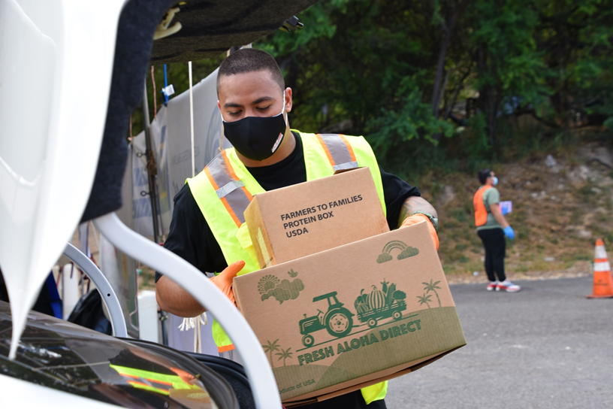
Questions?
Together, we can work to ensure no on in our Hawaii 'ohana goes hungry.

Slide 39
Thank you for your hearts and your commitment to serve.
Mahalo

